Slide 1

E-Commerce User Conversion Funnel & Revenue Optimization Analysis
Mayank Shukla – Google Cloud BigQuery

Slide 2

Business Context
E - commerce platform with user event tracking.
High traffic but low conversion efficiency.
Need to understand user journey.
Goal : Improve conversion & revenue.

Slide 3

Problem Statement
Identify funnel drop-off stages.
Measure conversion rates.
Evaluate revenue contribution by source.

Slide 4
Dataset Overview
Total Users :- 5000
Total Event Types :- 5
Event Type :- 1. page_view, 2. add_to_cart, 3. checkout_start, 4. payment_info, 5. purchase
Total Traffic Source :- 4
Traffic Source :- 1. email, 2. organic, 3. paid_ads, 4. social
Date Start :- 30-12-2025
Date End :- 03-02-2026
Total Rows :- 9381
Total Columns :- 7
Column Name :- 1. event_id, 2. user_id, 3. event_type, 4. event_date, 5. product_id, 6. amount, 7. traffic_source

Slide 5
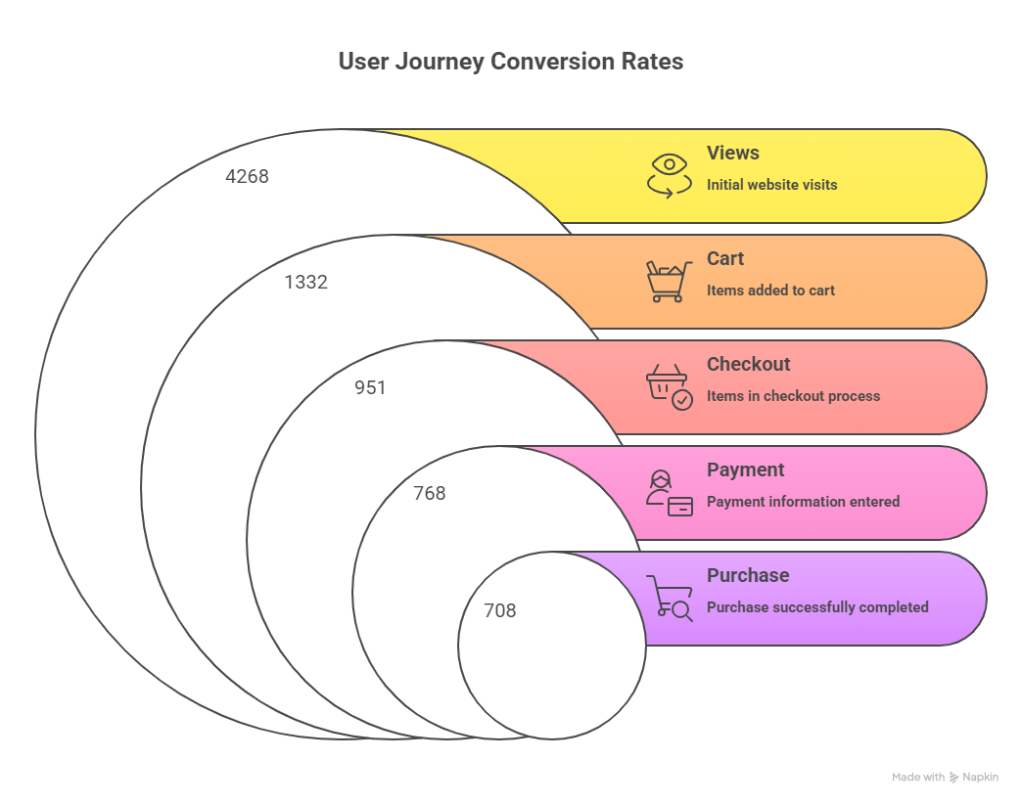

Slide 6
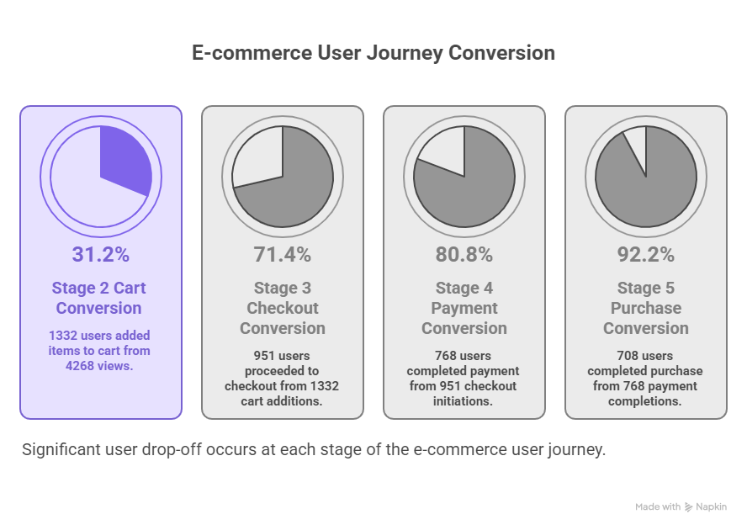

Slide 7
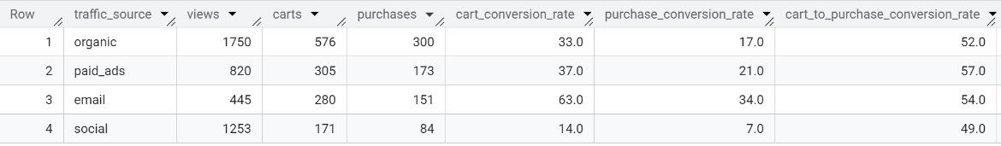
Funnel By Traffic Source

Slide 8
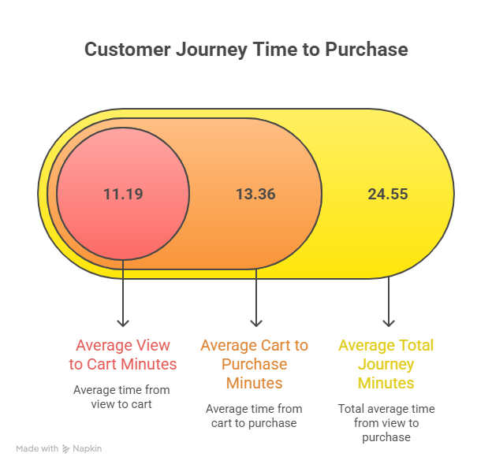

Slide 9
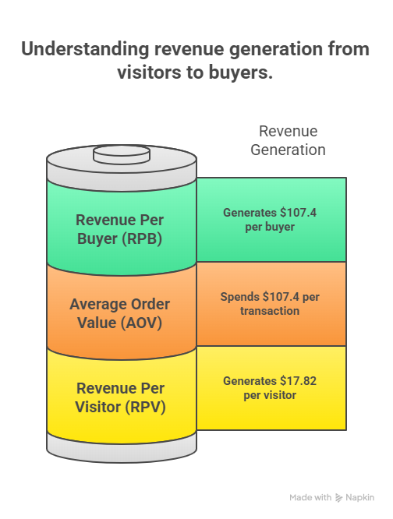
Total Revenue :- $ 76037
Overall Conversion Rate :- 16.6 %

Slide 10
Business Recommendations
UX & Website Optimization : Don’t touch the checkout flow, the conversion rates from Checkout Start to Purchase are excellent(~75%).
Marketing Strategy : Stop over-investing in social media for sales, Social media is driving 30% of our traffic volume but has the lowest conversion rate.
Double Down on Email Marketing : Email is our highest converting channel (~63%+ conversion rate vs ~ 14% for social media).
Financial & Revenue : We found our Average Order Value is ~$ 107.
Action : Set a strict Customer Acquisition Cost (CAC) limit. If we are paying more than $30 - $40 to acquire a customer via Social Media ads (Which convert poorly), we are likely loosing money on those specific transactions.

Slide 11

Thanks!
Do you have any questions?
mayankshukla310@gmail.com
+91 95095 46043

